Slide 1
Cyber Data Analytics CS4035 - 2020
Sicco Verwer
Christian Hammerschmidt
Priya Sarkar

Slide 2
Cyber Data Analytics
Aim
identify and prevent cyber criminals using machine learning
How
use any method you can get your hands on
adapt it to cyber data:
huge structured data sets with few positives (fortunately)
frequently unlabeled
often containing private information

Slide 3
Many kinds of models
Geometric models use intuitions from geometry such as separating (hyper-)planes, linear transformations and distance metrics.
Probabilistic models view learning as a process of reducing uncertainty, modeled by means of probability distributions.
Logical models are defined in terms of easily interpretable logical expressions.
Characterized by their way of working:
Grouping models divide the instance space into segments; in each segment a very simple (e.g., constant) model is learned.
Grading models learning a single, global model over the instance space.
slides based on Peter Flach

Slide 4
ML Taxonomy
grading
a bit
a lot
logical
geometric
yes
not so much
no
yes
supervised
Naïve Bayes
supervised
grouping
no
yes
no
some
association rules
trees & rules
Mixture Models
linear classifiers
supervised
no
yes
The colors indicate the type of model, from left to right: logical, probabilistic and geometric.
Support Vector Machines
k-means
nearest neigbour
slides based on Peter Flach

Slide 5

Need more background?
Excellent text book, contains intuitive explanations of many of the basic machine learning methods and algorithms
https://www.cs.bris.ac.uk/~flach/mlbook/
Highly recommended

Slide 6

Free background (for all)
Excellent textbook, quite some
math, but also very good intuition
http://statweb.stanford.edu/~tibs/ElemStatLearn/download.html
including some R code:
http://statweb.stanford.edu/~tibs/ElemStatLearn/

Slide 7

Free background (from university)
Good overview of basic data
preprocessing, classification,
pattern mining, and clustering
little geometric, mostly logical
http://www.sciencedirect.com/science/book/9780123814791

Slide 8

Free background (from university)
Practical data mining in Weka
http://www.cs.waikato.ac.nz/ml/weka/
http://www.sciencedirect.com/science/book/9780123748560

Slide 9
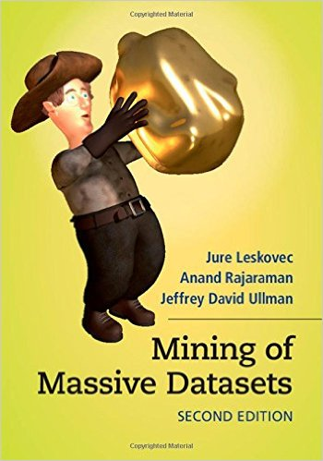
Free background (for all)
Great text on learning
from big data
Some content taught
in this course!
http://infolab.stanford.edu/~ullman/mmds/book.pdf

Slide 10

Tools --- for the labs we use Scikitlearn and Jupyter Notebooks
Scikitlearn – Python (we will mostly use this)
http://scikit-learn.org/
R – (e1071 package!, svmlib!)
https://www.r-project.org/
Matlab (and prtools!)
http://prtools.org/
Weka, see previous slide
KNIME or RAPIDminer (GUIs, recommended for novices)
https://www.knime.org/
https://rapidminer.com/

Slide 11
Rules
Grade determined 100% by lab work
Grade needs to be at least 6
4 lab assignments, first one released this week
2 types of tasks:
Solving given problems using taught techniques
Apply techniques yourself to given data
Each lab contains individual components!
Write 4 small reports
max 4 pages each, 2 figures as appendix are allowed
including solutions for the given exercise and analysis of the data
code included in Python Jupyter notebook
Grades are based on quality of techniques used, problem solving capability, not on resulting classifier accuracy!
Feedback using peer-review, grading uses reviews as guidance

Slide 12
Communication
Materials are on BrightSpace
currently last-years material
updates will be posted after every lecture
Code/tools will be posted on Brightspace and Gitlab
Communication/questions via Mattermost

Slide 13
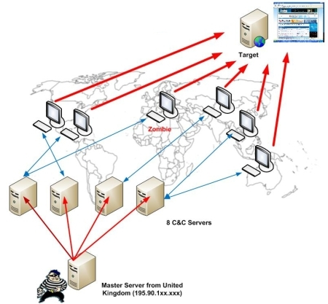
Botnets
Distributed malicious software
Control architecture
Thousands-millions of zombies
Used for massive DDoS attacks, sending spam, and keylogging

Slide 14


Preventing botnets
Traditional
code analysis and finding malware fingerprints
Code/binary analysis is mostly manual and increasingly harder
Code obfuscation
Encryption
Self-modifying
Behavior-based analysis is much harder to thwart
Bots need to communicate!

Slide 15
Preventing botnets
Traditional
code analysis and finding malware fingerprints
Code/binary analysis is mostly manual and increasingly harder
Code obfuscation
Encryption
Self-modifying
Behavior-based analysis is much harder to thwart
Bots need to communicate!
Lots of data available…

Slide 16
Binary code (Zeus)
4D 5A 00 00 00 00 00 00 00 00 00 00 00 00 00 00 00 00 00 00 00 00 00 00 00 00 00 00 00 00 00 00 00 00 00 00 00 00 00 00 00 00 00 00 00 00 00 00 00 00 00 00 00 00 00 00 00 00 00 00 D8 00 00 00 00 00 00 00 00 00 00 00 00 00 00 00 00 00 00 00 00 00 00 00 00 00 00 00 00 00 00 00 00 00 00 00 00 00 00 00 00 00 00 00 00 00 00 00 00 00 00 00 00 00 00 00 00 00 00 00 00 00 00 00 00 00 00 00 00 00 00 00 00 00 00 00 00 00 00 00 00 00 00 00 00 00 00 00 00 00 00 00 00 00 00 00 00 00 00 00 00 00 00 00 00 00 00 00 00 00 00 00 00 00 00 00 00 00 00 00 00 00 00 00 00 00 00 00 00 00 00 00 00 00 00 00 00 00 00 00 00 00 00 00 00 00 00 00 00 00 00 00 00 00 00 00 50 45 00 00 4C 01 03 00 75 39 B2 52 00 00 00 00 00 00 00 00 E0 00 02 01 0B 01 0A 00 00 08 02 00 00 3A 00 00 00 00 00 00 48 30 01 00 00 10 00 00 00 20 02 00 00 00 40 00 00 10 00 00 00 02 00 00 05 00 01 00 01 00 00 00 05 00 01 00 00 00 00 00 00 70 02 00 00 04 00 00 00 00 00 00 02 00 00 81 00 00 10 00 00 10 00 00 00 00 10 00 00 10 00 00 00 00 00 00 10 00 00 00 00 00 00 00 00 00 00 00 A4 F7 01 00 18 01 00 00 00 00 00 00 00 00 00 00 00 00 00 00 00 00 00 00 00 00 00 00 00 00 00 00 00 50 02 00 AC 11 00 00 00 00 00 00 00 00 00 00 00 00 00 00 00 00 00 00 00 00 00 00 00 00 00 00 00 00 00 00 00 00 00 00 00 00 00 00 00 00 00 00 00 00 00 00 00 00 00 00 00 10 00 00 A0 05 00 00 00 00 00 00 00 00 00 00 00 00 00 00 00 00 00 00 00 00 00 00 00 00 00 00 2E 74 65 78 74 00 00 00 84 06 02 00 00 10 00 00 00 08 02 00 00 04 00 00 00 00 00 00 00 00 00 00 00 00 00 00 20 00 00 60 2E 64 61 74 61 00 00 00 50 20 00 00 00 20 02 00 00 04 00 00 00 0C 02 00 00 00 00 00 00 00 00 00 00 00 00 00 40 00 00 C0 2E 72 65 6C 6F 63 00 00 7C 16 00 00 00 50 02 00 00 18 00 00 00 10 02 00 00 00 00 00 00 00 00 00 00 00 00 00 40 00 00 42 00 00 00 00 00 00 00 00 00 00 00 00 00 00 00 00 00 00 00 00 00 00 00 00

Slide 17
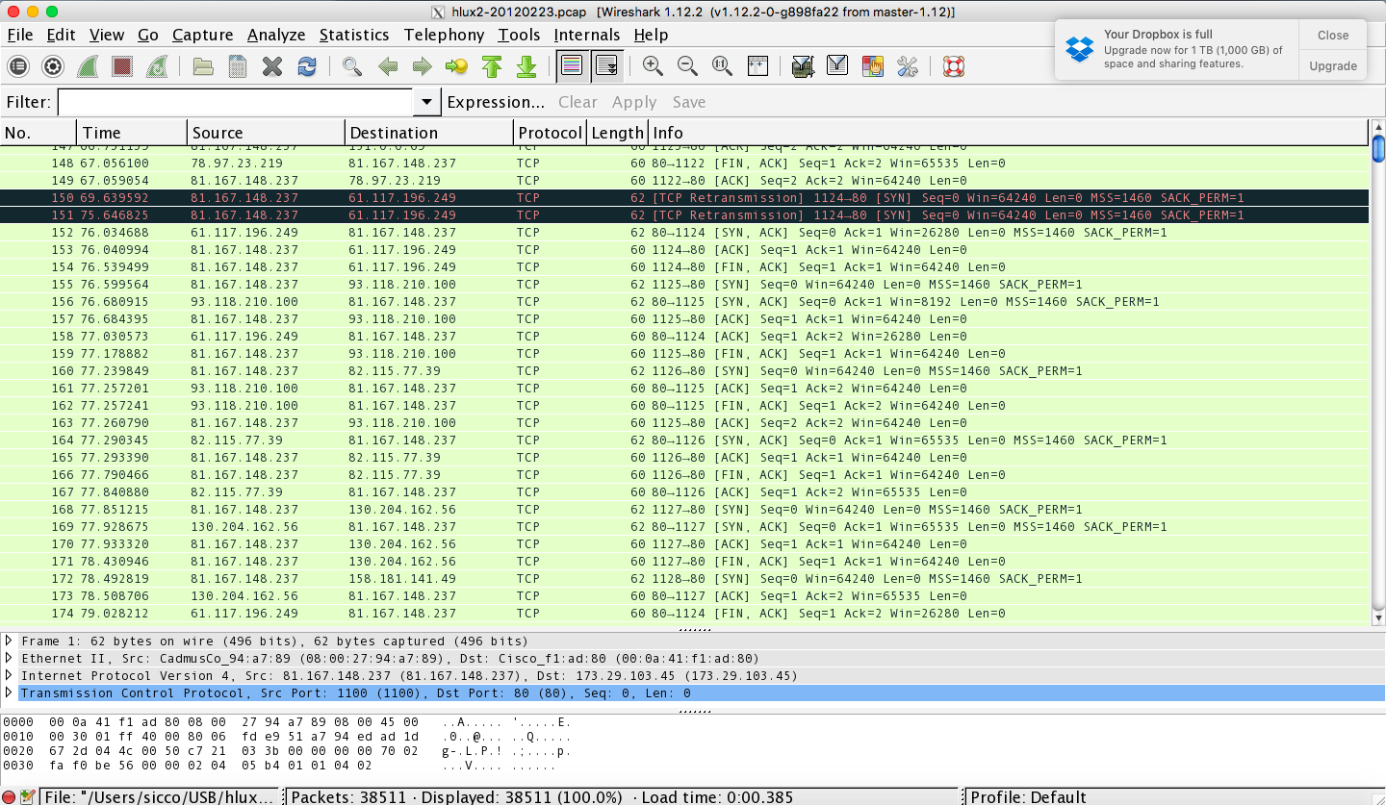
Network traffic (HLUX2)

Slide 18
Machine learning
test data
Classic Approach:
take a huge data set
compute features
train a classifier
deploy the classifier on test
learning
algorithm
model
train data
output

Slide 19
Classic ML fails in cyber security
Large majority (> 99%) of cases are benign
Data is sequential
Data is massive and keeps coming in
There is an opponent, they learn too
Privacy
Q: what are the problems?

Slide 20
Classic ML fails in cyber security
Large majority (> 99%) of cases are benign
Most classifiers are happy with 99% accuracy
Data is sequential
Not IID: Independently and Identically Distributed
Data is massive and keeps coming in
Loading data fails
There is an opponent
And (s)he will modify the testing data
Privacy
Makes data inaccessible

Slide 21
1. Imbalanced data
The all negative classifier (everything benign) reaches over 99% accuracy!
3 simple solutions:
Resampling
oversample/undersample minority/majority class
Reweighting
assign large/small weights to minority/majority class
Synthesizing
add artificial minority class instances

Slide 22
1. Imbalanced data
The all negative classifier (everything benign) reaches over 99% accuracy!
3 simple solutions:
Resampling
oversample/undersample minority/majority class
Reweighting
assign large/small weights to minority/majority class
Synthesizing
add artificial minority class instances

Slide 23
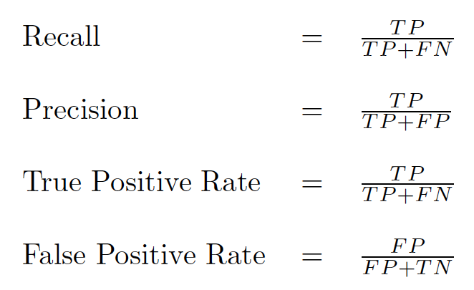
Measuring performance
Standard measures:

Slide 24
Measuring performance
Standard measures:
Q: what is most important?

Slide 25
Measuring performance
Standard measures:
Most important criteria: every false positive
equals an unneeded investigation!

Slide 26
Acceptable FP rate: learn a ranker!
Instead of labeling true/false, assign a value
rank or probability
Using ranks, order the test labels:
rank | 1 | 2 | 3 | 4 | 5 | 6 | 7 | 8 | 9 | 10
label | - | - | + | - | - | + | + | - | + | +

Slide 27
Acceptable FP rate: learn a ranker!
Instead of labeling true/false, assign a value
rank or probability
Using ranks, order the test labels:
rank | 1 | 2 | 3 | 4 | 5 | 6 | 7 | 8 | 9 | 10
label | - | - | + | - | - | + | + | - | + | +
Q: what is a good threshold?

Slide 28
Acceptable FP rate: learn a ranker!
Instead of labeling true/false, assign a value
rank or probability
Using ranks, order the test labels:
Which threshold to use?
FPR = 3/5 1/5 0/5
TPR = 5/5 4/5 2/5
rank | 1 | 2 | 3 | 4 | 5 | 6 | 7 | 8 | 9 | 10
label | - | - | + | - | - | + | + | - | + | +

Slide 29
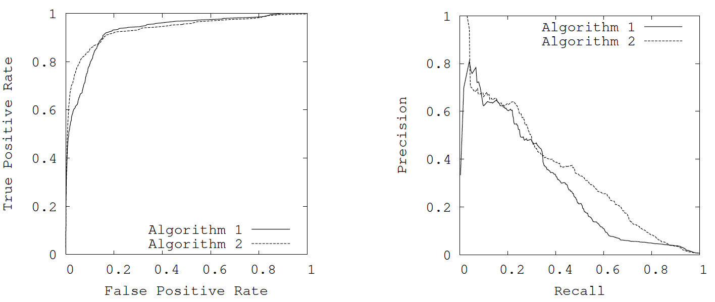
Plot values for all thresholds
Make ROC curves or PR curves to decide which ranker is best…

Slide 30
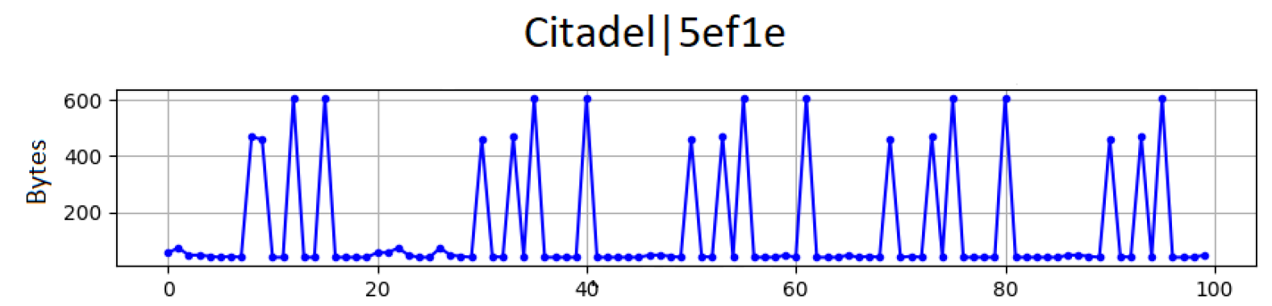
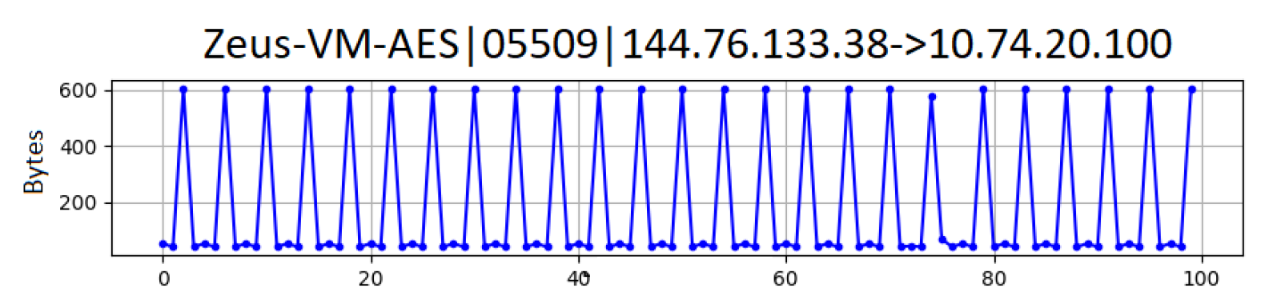
2. Data is sequential
b

Slide 31
2. Data is sequential
Q: how to use this data?

Slide 32
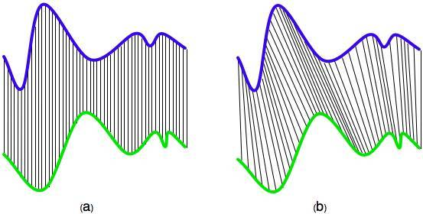
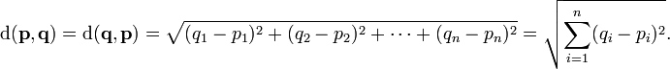
Sequences unaligned

Slide 33
Sequence alignment
Aligns time-series non-linearly in time, finds the best match

Slide 34
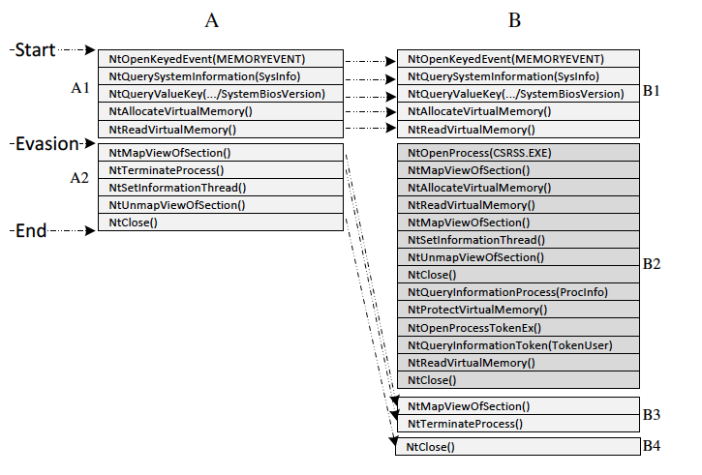
Sequence alignment
Used in e.g. system call traces:
Aligns time-series non-linearly in time, finds the best match

Slide 35
In malware packet traces

Slide 36
3. Data is massive and continuous…
Machine learning uses counts
statistics, distances, etc.
Simple solution:
count approximately with hash functions! (in this course)
More complex:
apply distributed data processing… (not in this course)

Slide 37
Problem statement
A set W containing m values
IP addresses, email addresses, etc.
Memory of size n
Goal: data structure that allows efficient checking whether an element in the stream is in W
return TRUE with probability 1 if it is indeed in W
return FALSE with high probability if it is not in W
Slides from Claudia Hauff
Notes:
Q: How many possible IP addresses are there?

Slide 38
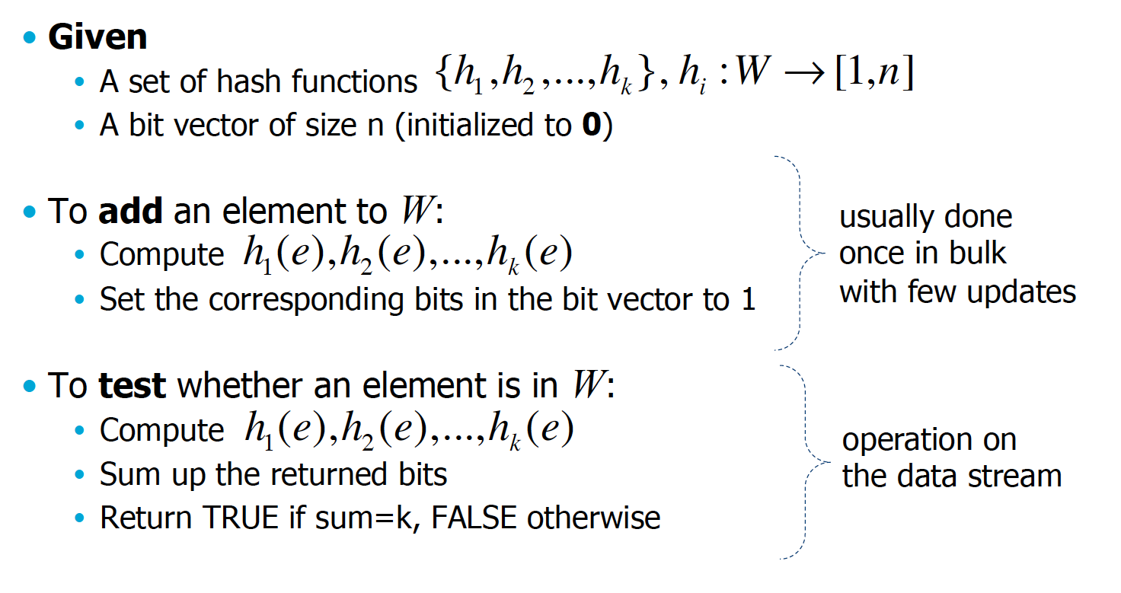
Bloom filter

Slide 39
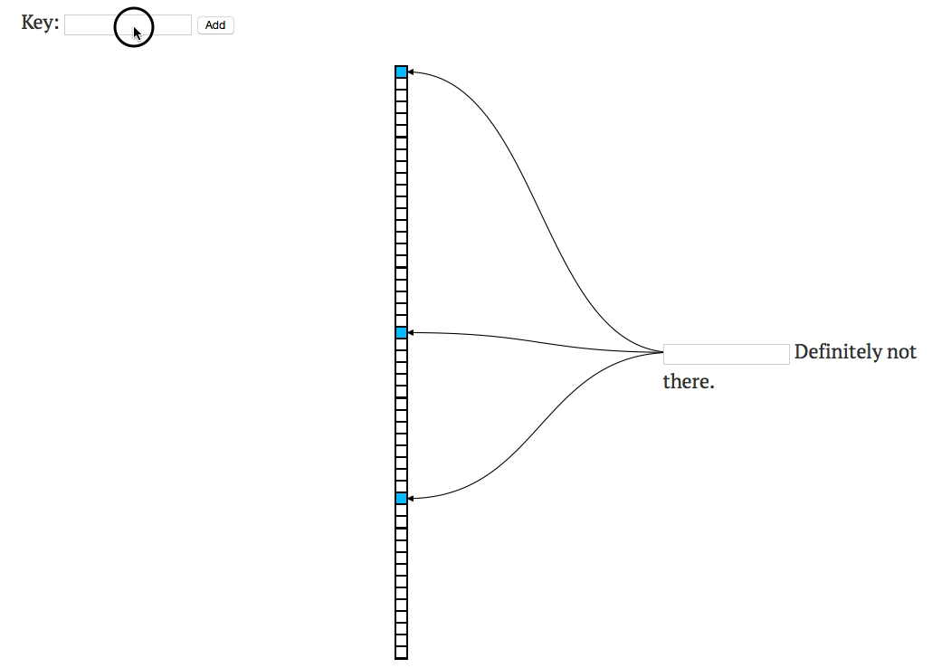
Bloom filter: a demo
http://www.jasondavies.com/bloomfilter/

Slide 40
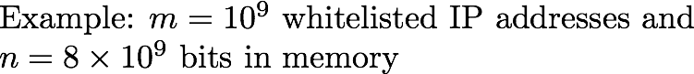
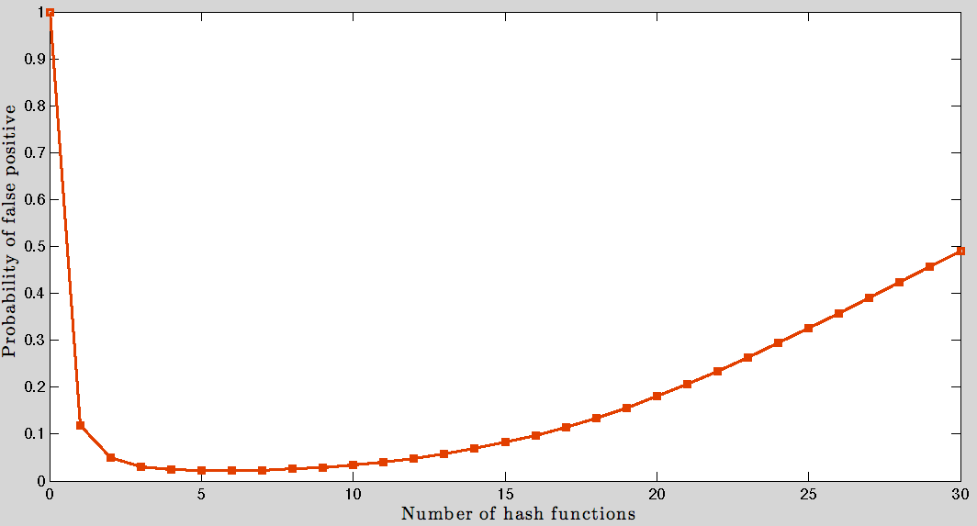
Bloom filter: how many hashes?

Slide 41
4. Dealing with opponents
For malware X
Learn a distribution D_{X} over X’s data
Markov chain, n-gram, naïve Bayes, …. more complex
For a new data sample S
Return P( S | D_{X} )
assume maximum-likelihood model
detect same behavior if P > threshold
…
Q: what to do?

Slide 42
4. Dealing with opponents
For malware X
Learn a distribution D_{X} over X’s data
Markov chain, n-gram, naïve Bayes, …. more complex
For a new data sample S
Return P( S | D_{X} )
assume maximum-likelihood model
detect same behavior if P > threshold
…

Slide 43
N-grams
s1 | s2 | s3
1 | 1 | 2
1 | 2 | 3
2 | 3 | 3
3 | 3 | 1
3 | 1 | 2
1 | 2 | 3
2 | 3 | 3
3 | 3 | 3
Given sequence:
1,1,2,3,3,1,2,3,3,3
Take windows:
1,1,2,3,3,1,2,3,3,3

Slide 44
N-grams
Every combination of past sequences is a state
States:
11, 21, 31
12, 22, 32
13, 23, 33
Transitions:
P(11→12) = P(2|11) =
P(112) / P(11?)
s1 | s2 | s3
1 | 1 | 2
1 | 2 | 3
2 | 3 | 3
3 | 3 | 1
3 | 1 | 2
1 | 2 | 3
2 | 3 | 3
3 | 3 | 3

Slide 45
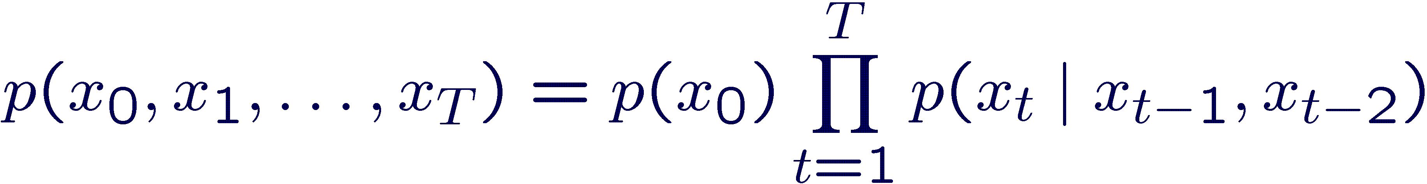
N-grams
Every combination of past
sequences is a state
s1 | s2 | s3
1 | 1 | 2
1 | 2 | 3
2 | 3 | 3
3 | 3 | 1
3 | 1 | 2
1 | 2 | 3
2 | 3 | 3
3 | 3 | 3
Prob(1123) =
P(11) * P(11→12) * P(12→23) =
?

Slide 46
N-grams
Every combination of past
sequences is a state
s1 | s2 | s3
1 | 1 | 2
1 | 2 | 3
2 | 3 | 3
3 | 3 | 1
3 | 1 | 2
1 | 2 | 3
2 | 3 | 3
3 | 3 | 3
Prob(1123) =
P(11) * P(11→12) * P(12→23) =
? = 1/8 * 1 * 1 = 1/8

Slide 47
N-grams
Popular tools in natural language processing (NLP)
Other names:
bigrams, trigrams, higher-order Markov chains, shingles
Almost always need to be combined with smoothing methods
add a count of 1 to all occurrences (Laplace)
avoids overfitting
Simple to use, but the size can blow-up when the alphabet gets large (e.g., all the words in a language)
HASH!
Commonly used to detect malware using Byte N-grams!

Slide 48
Binary code (Zeus)
4D 5A 00 00 00 00 00 00 00 00 00 00 00 00 00 00 00 00 00 00 00 00 00 00 00 00 00 00 00 00 00 00 00 00 00 00 00 00 00 00 00 00 00 00 00 00 00 00 00 00 00 00 00 00 00 00 00 00 00 00 D8 00 00 00 00 00 00 00 00 00 00 00 00 00 00 00 00 00 00 00 00 00 00 00 00 00 00 00 00 00 00 00 00 00 00 00 00 00 00 00 00 00 00 00 00 00 00 00 00 00 00 00 00 00 00 00 00 00 00 00 00 00 00 00 00 00 00 00 00 00 00 00 00 00 00 00 00 00 00 00 00 00 00 00 00 00 00 00 00 00 00 00 00 00 00 00 00 00 00 00 00 00 00 00 00 00 00 00 00 00 00 00 00 00 00 00 00 00 00 00 00 00 00 00 00 00 00 00 00 00 00 00 00 00 00 00 00 00 00 00 00 00 00 00 00 00 00 00 00 00 00 00 00 00 00 00 50 45 00 00 4C 01 03 00 75 39 B2 52 00 00 00 00 00 00 00 00 E0 00 02 01 0B 01 0A 00 00 08 02 00 00 3A 00 00 00 00 00 00 48 30 01 00 00 10 00 00 00 20 02 00 00 00 40 00 00 10 00 00 00 02 00 00 05 00 01 00 01 00 00 00 05 00 01 00 00 00 00 00 00 70 02 00 00 04 00 00 00 00 00 00 02 00 00 81 00 00 10 00 00 10 00 00 00 00 10 00 00 10 00 00 00 00 00 00 10 00 00 00 00 00 00 00 00 00 00 00 A4 F7 01 00 18 01 00 00 00 00 00 00 00 00 00 00 00 00 00 00 00 00 00 00 00 00 00 00 00 00 00 00 00 50 02 00 AC 11 00 00 00 00 00 00 00 00 00 00 00 00 00 00 00 00 00 00 00 00 00 00 00 00 00 00 00 00 00 00 00 00 00 00 00 00 00 00 00 00 00 00 00 00 00 00 00 00 00 00 00 10 00 00 A0 05 00 00 00 00 00 00 00 00 00 00 00 00 00 00 00 00 00 00 00 00 00 00 00 00 00 00 2E 74 65 78 74 00 00 00 84 06 02 00 00 10 00 00 00 08 02 00 00 04 00 00 00 00 00 00 00 00 00 00 00 00 00 00 20 00 00 60 2E 64 61 74 61 00 00 00 50 20 00 00 00 20 02 00 00 04 00 00 00 0C 02 00 00 00 00 00 00 00 00 00 00 00 00 00 40 00 00 C0 2E 72 65 6C 6F 63 00 00 7C 16 00 00 00 50 02 00 00 18 00 00 00 10 02 00 00 00 00 00 00 00 00 00 00 00 00 00 40 00 00 42 00 00 00 00 00 00 00 00 00 00 00 00 00 00 00 00 00 00 00 00 00 00 00 00
s1 | s2 | s3
4D | 5A | 00
5A | 00 | 00
00 | 00 | 00
00 | 00 | 00
00 | 00 | 00
00 | 00 | 00
00 | 00 | 00
…

Slide 49
Why Byte N-grams?
“N-grams have the ability to capture implicit features of the input that are difficult to detect explicitly. As a growing number of malware writers use tools to write and compile their code, n-grams could detect features of the code that are specific for certain tools, or families of tools, including code generators, compilers, and programming environment. In addition, n-grams could capture features that are specific for authors, coding styles, or even behavioral features.”
Detection of New Malicious Code Using N-grams Signatures
Tony Abou-Assaleh, Nick Cercone, Vlado Keselj, and Ray Sweidan

Slide 50
Network traffic (HLUX2)

Slide 51
Network traffic (HLUX2)
s1 | s2 | s3
..249->..237,TCP,SYN+ACK | ..237->..249,TCP,ACK | ..237->..249,TCP,FIN+ACK
..237->..249,TCP,ACK | ..237->..249,TCP,FIN+ACK | ..237->..100,TCP,SYN
..237->..249,TCP,FIN+ACK | ..237->..100,TCP,SYN | ..100->..237,TCP,SYN+ACK

Slide 52
Network traffic (HLUX2)
Finding a good mapping
from raw traffic to
discrete symbols
is key
Often people simply use k-means clustering
s1 | s2 | s3
..249->..237,TCP,SYN+ACK | ..237->..249,TCP,ACK | ..237->..249,TCP,FIN+ACK
..237->..249,TCP,ACK | ..237->..249,TCP,FIN+ACK | ..237->..100,TCP,SYN
..237->..249,TCP,FIN+ACK | ..237->..100,TCP,SYN | ..100->..237,TCP,SYN+ACK

Slide 53
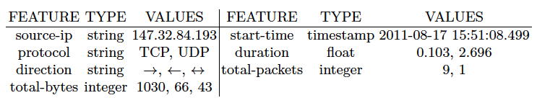
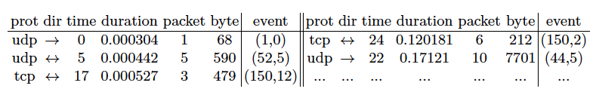
Profiling network traffic
Our own work on NetFlow traces
Translate into discrete sequences:
Sicco Verwer

Slide 54
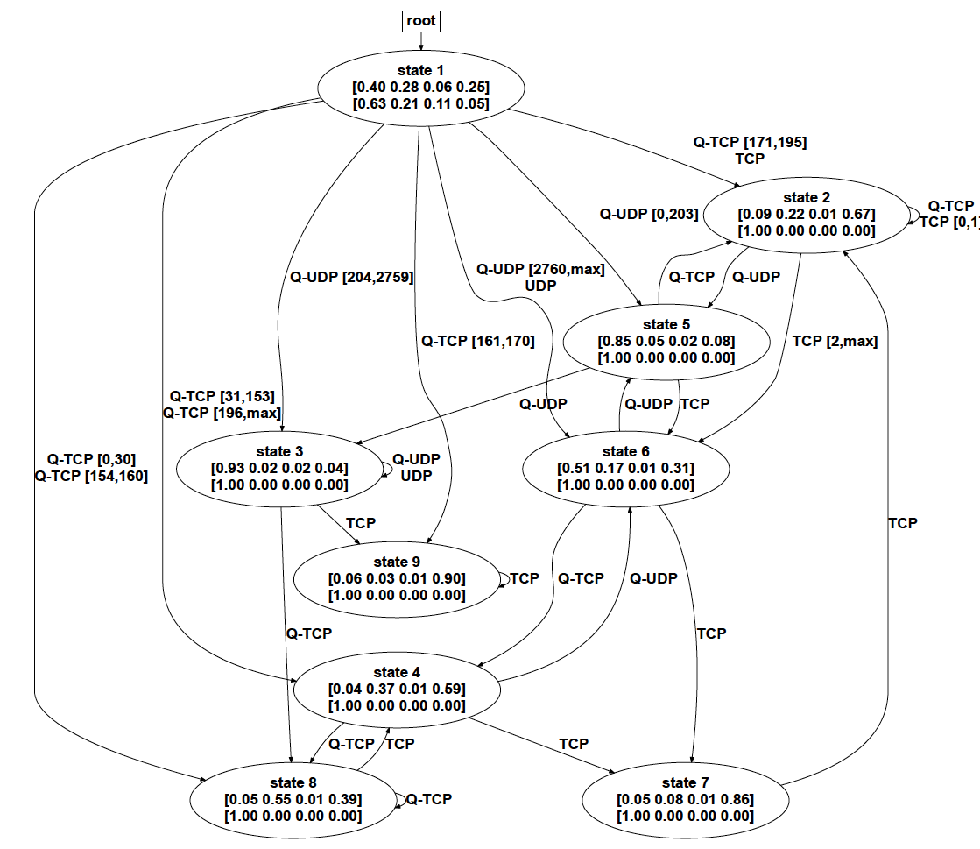
A probabilistic model for malware
Sicco Verwer

Slide 55
A probabilistic model for malware
Q: how to use this model?
Sicco Verwer

Slide 56
A probabilistic model for malware
Profiling:
Behavior of new data set should fit
the learned distribution
Sicco Verwer

Slide 57
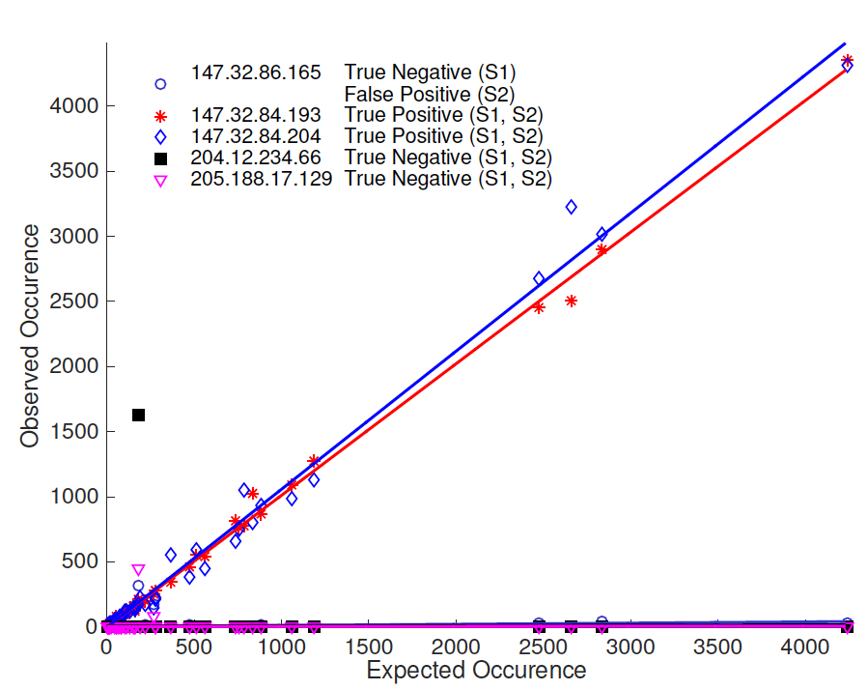
Profiling: observed vs expected events

Slide 58
Results
4 scenarios: click-fraud, spamming, DDoS, …
For each scenario:
Learn state machine model from 1 malicious host
Behavioral difference is small → malicious
TP | TN | FP | FN
9 | 377 | 0 | 0
9 | 153 | 0 | 0
1 | 35 | 0 | 1
0 | 7 | 0 | 2
Sicco Verwer

Slide 59
Results - anomaly detection
4 scenarios: click-fraud, spamming, DDoS, …
For each scenario:
Learn models from a large set of benign hosts
Behavioral difference to every model is large → malicious
TP | TN | FP | FN
10 | 561 | 3 | 0
10 | 225 | 6 | 0
2 | 50 | 4 | 1
0 | 8 | 1 | 3
Sicco Verwer

Slide 60
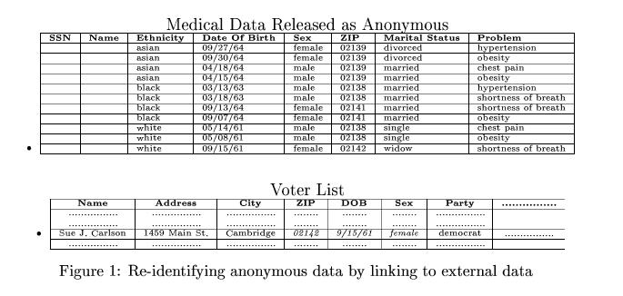
The privacy issue: record linkage
Massachusetts hospital discharge dataset
Public voter dataset
Latanya Sweeney
Sicco Verwer

Slide 61
Privacy: LEHD data
http://lehd.ces.census.gov/data/
Measure anonymity sets:
The size of the set of people with identical values for quantities of interest (work-home locations)
Sicco Verwer

Slide 62
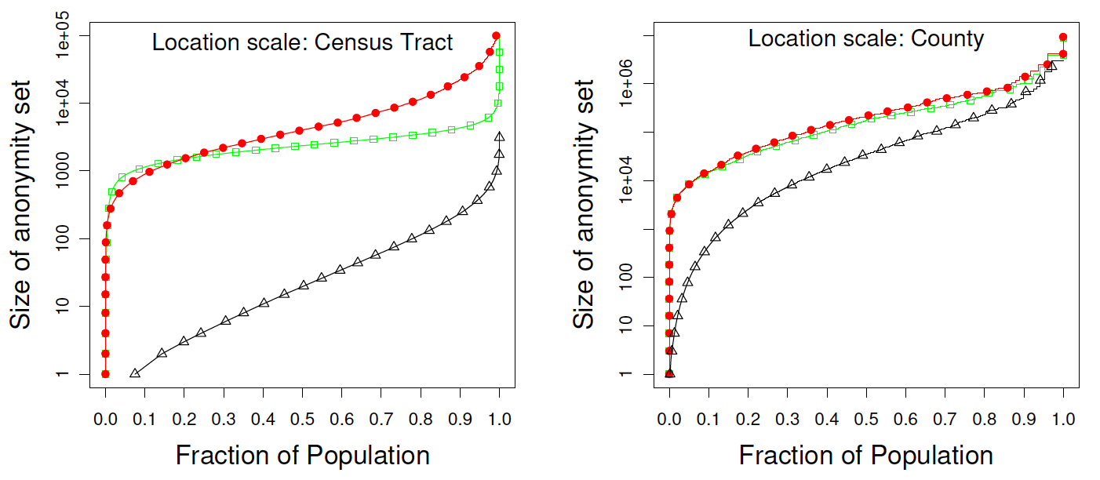
Fraction of people in A.S. of size Y
Red = revealing only work location, Green = revealing only home location
Grey = revealing both
On the Anonymity of Home/Work Location Pairs
Philippe Golle and Kurt Partridge
Sicco Verwer

Slide 63
Classic ML fails in cyber security
Large majority (> 99%) of cases are benign
Resample/synthesize data, ROC/PR analysis!
Data is sequential
Look for temporal patterns!
Data is massive and keeps coming in
Hash to approximate, distribute if possible!
There is an opponent, they learn too
Detect behavior instead of predefined patterns! …
Privacy makes data inaccessible…
Privacy preserving data mining…
Sicco Verwer

Slide 64
Lab 1 - fraud

Slide 65
Credit card transaction data
Every row is one transaction

Slide 66
Credit card transaction data
Every row is one transaction
Which transactions are fraudulent?

Slide 67
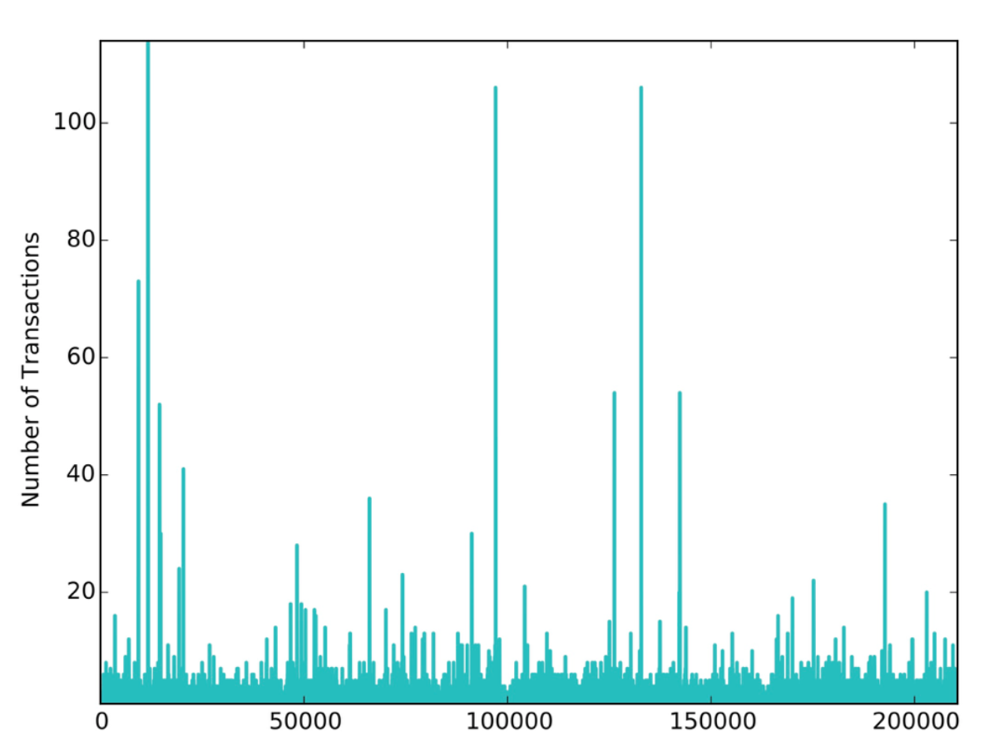
Credit card transaction data
Every row is one transaction
Transactions per client

Slide 68
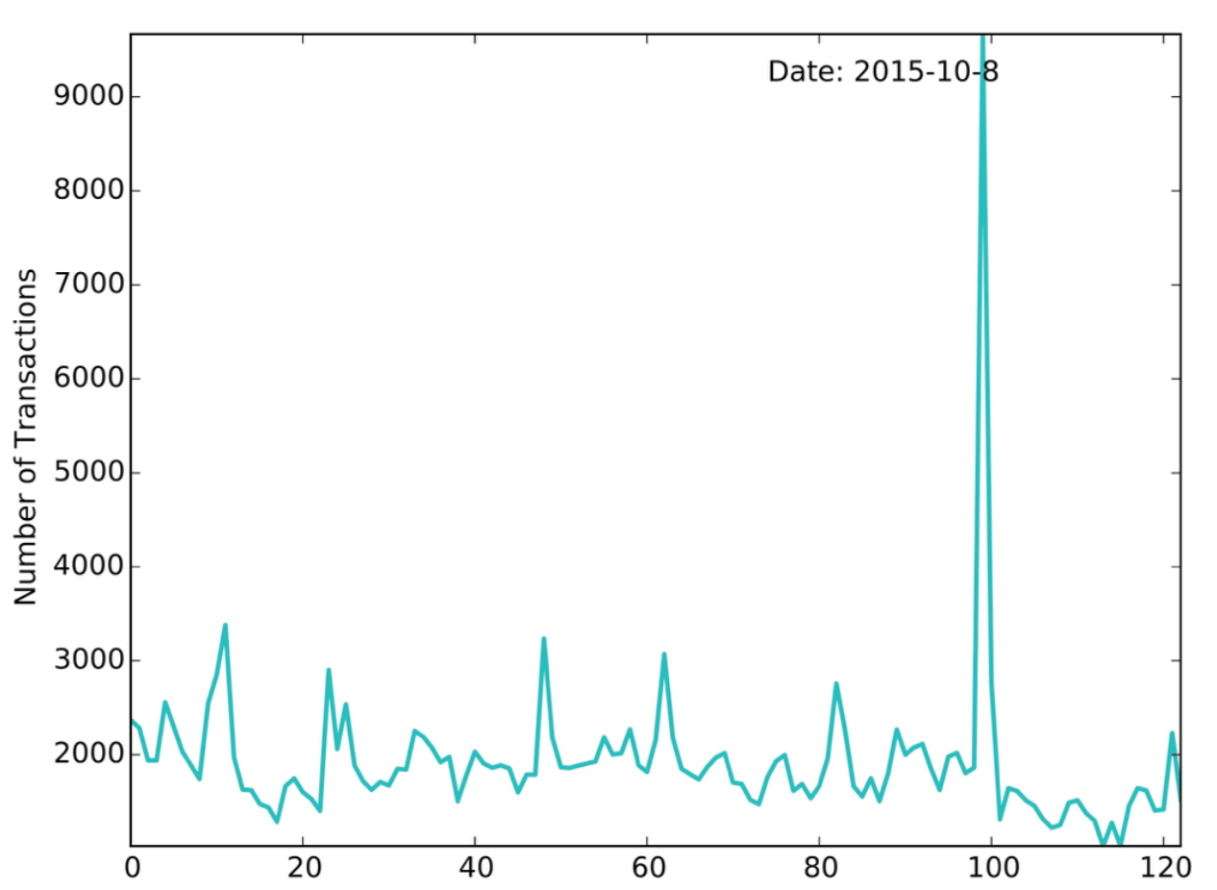
Credit card transaction data
Every row is one transaction
Transactions per day

Slide 69
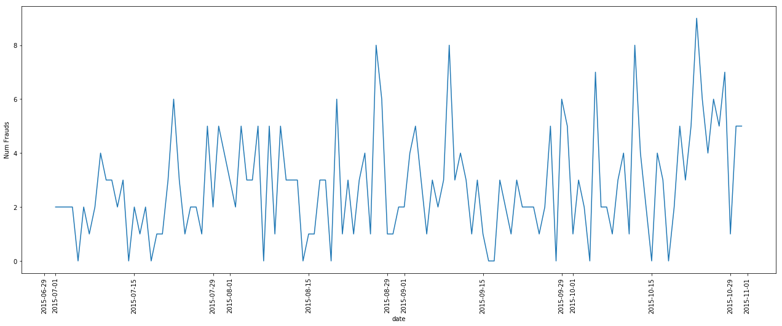
Credit card transaction data
Fraudulent Transactions per day

Slide 70
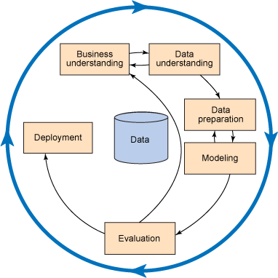
Many different views
Data can be aggregated in many different ways
understand the goal!
understand the data!
before modeling!
Key tool: visualization
heat maps
cross tables
pair-wise scatterplots
parallel coordinates
…

Slide 71
Many different views
Data can be aggregated in many different ways
understand the goal!
understand the data!
before modeling!
Key tool: visualization
heat maps
cross tables
pair-wise scatterplots
parallel coordinates
…
Sicco’s HMF-rule:
Heat Maps First!
CRISP-DM

Slide 72
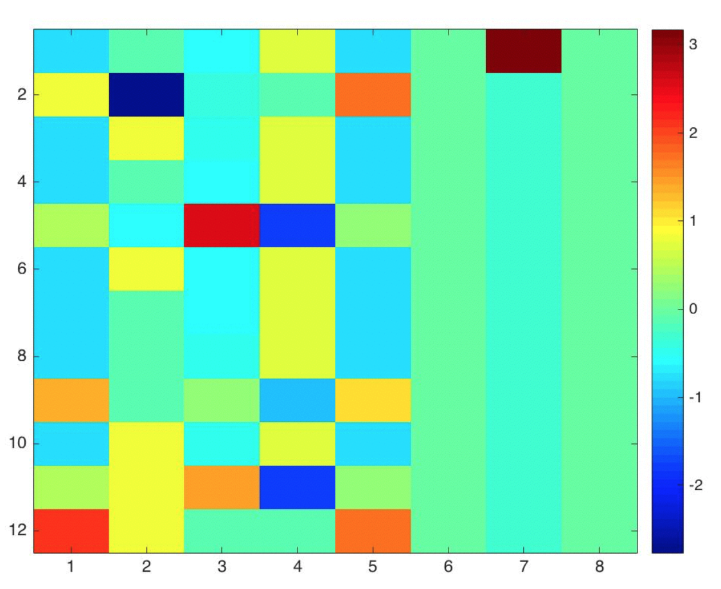
Make heatmaps!

Slide 73
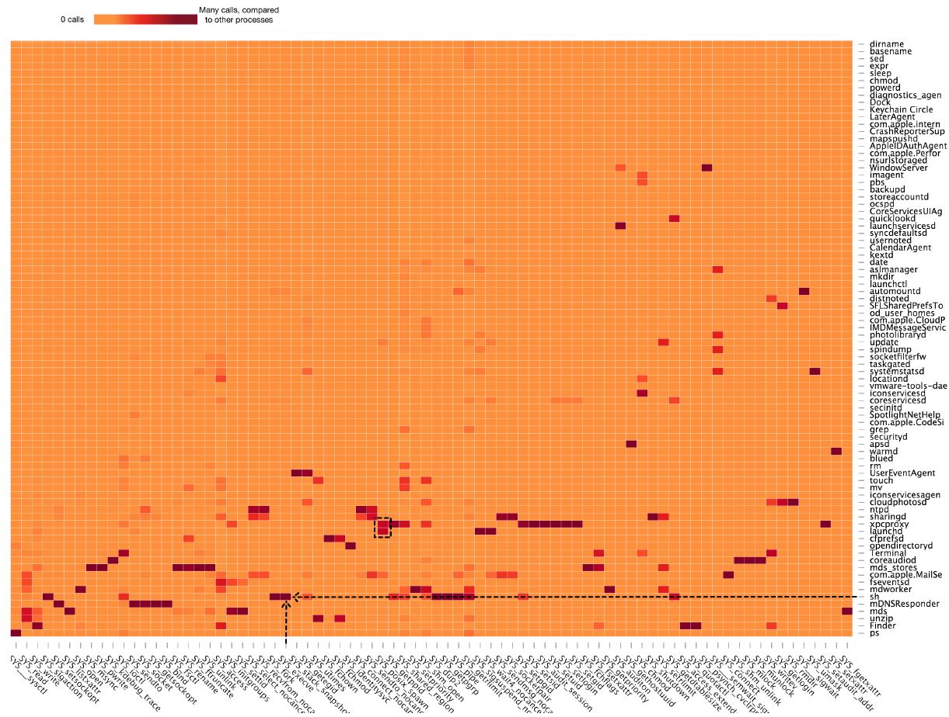
The power of heatmaps - malware

Slide 74
The power of heatmaps - ethereum
0 | 1409994 | 61747 | 274247 | 179377 | 179377 | 179377 | 179377 | 194377 | 179377 | 169247 | 169247 | 184247 | 184247 | 169247 | 169247 | 169247 | 169247 | 184247 | 184247 | 184247 | 184247
0 | 1410058 | 61747 | 274247 | 169247 | 169247 | 169247 | 169247 | 184247 | 169247 | 169247 | 169247 | 184247 | 184247 | 169247 | 169247 | 169247 | 169247 | 184247 | 184247 | 184247 | 184247
0 | 1410058 | 61747 | 274247 | 169247 | 169247 | 169247 | 169247 | 194377 | 179377 | 179377 | 179377 | 184247 | 184247 | 169247 | 169247 | 169247 | 169247 | 184247 | 184247 | 184247 | 184247
0 | 1410058 | 61747 | 284377 | 169247 | 169247 | 169247 | 169247 | 184247 | 169247 | 169247 | 169247 | 184247 | 184247 | 169247 | 169247 | 169247 | 169247 | 184247 | 184247 | 184247 | 184247
0 | 1410122 | 61747 | 274247 | 169247 | 169247 | 169247 | 169247 | 184247 | 169247 | 169247 | 169247 | 184247 | 184247 | 169247 | 169247 | 169247 | 169247 | 184247 | 184247 | 184247 | 184247
0 | 1410122 | 61747 | 274247 | 169247 | 169247 | 169247 | 169247 | 184247 | 169247 | 179377 | 179377 | 194377 | 194377 | 179377 | 179377 | 169247 | 169247 | 184247 | 184247 | 184247 | 184247
0 | 1410122 | 61747 | 274247 | 169247 | 169247 | 179377 | 179377 | 194377 | 179377 | 179377 | 169247 | 184247 | 184247 | 169247 | 169247 | 169247 | 169247 | 184247 | 184247 | 184247 | 184247
0 | 1410122 | 61747 | 284377 | 169247 | 169247 | 169247 | 169247 | 184247 | 169247 | 169247 | 169247 | 184247 | 184247 | 169247 | 169247 | 169247 | 169247 | 184247 | 184247 | 184247 | 184247
0 | 1410122 | 61747 | 284377 | 179377 | 179377 | 179377 | 179377 | 194377 | 169247 | 169247 | 169247 | 184247 | 184247 | 169247 | 169247 | 169247 | 169247 | 184247 | 184247 | 184247 | 184247
2 | 1410058 | 61747 | 274247 | 169247 | 169247 | 169247 | 169247 | 184247 | 169247 | 169247 | 169247 | 184247 | 184247 | 169247 | 169247 | 169247 | 169247 | 184247 | 184247 | 184247 | 184247
2 | 1410058 | 61747 | 274247 | 169247 | 169247 | 169247 | 169247 | 184247 | 169247 | 169247 | 169247 | 184247 | 184247 | 169247 | 179377 | 179377 | 179377 | 184247 | 184247 | 184247 | 184247
2 | 1410058 | 61747 | 274247 | 169247 | 169247 | 169247 | 169247 | 184247 | 169247 | 179377 | 179377 | 194377 | 194377 | 179377 | 179377 | 179377 | 169247 | 184247 | 184247 | 184247 | 184247
2 | 1410058 | 61747 | 284377 | 179377 | 169247 | 169247 | 169247 | 184247 | 169247 | 169247 | 169247 | 184247 | 184247 | 169247 | 169247 | 169247 | 169247 | 184247 | 184247 | 184247 | 184247
2 | 1410122 | 61747 | 274247 | 169247 | 169247 | 169247 | 169247 | 184247 | 169247 | 169247 | 169247 | 184247 | 184247 | 169247 | 169247 | 169247 | 169247 | 184247 | 184247 | 184247 | 184247
2 | 1410122 | 61747 | 274247 | 169247 | 169247 | 169247 | 169247 | 184247 | 169247 | 169247 | 169247 | 184247 | 184247 | 169247 | 169247 | 169247 | 169247 | 184247 | 194377 | 194377 | 194377
2 | 1410122 | 61747 | 274247 | 169247 | 169247 | 179377 | 179377 | 194377 | 179377 | 179377 | 179377 | 184247 | 184247 | 169247 | 169247 | 169247 | 169247 | 184247 | 184247 | 184247 | 184247
2 | 1410122 | 61747 | 274247 | 179377 | 179377 | 179377 | 179377 | 194377 | 179377 | 179377 | 179377 | 194377 | 184247 | 169247 | 169247 | 169247 | 169247 | 184247 | 184247 | 184247 | 184247
2 | 1410122 | 61747 | 284377 | 179377 | 179377 | 179377 | 169247 | 184247 | 169247 | 169247 | 169247 | 184247 | 184247 | 169247 | 169247 | 169247 | 169247 | 184247 | 184247 | 184247 | 184247
2 | 1410122 | 61747 | 284377 | 179377 | 179377 | 179377 | 179377 | 194377 | 169247 | 169247 | 169247 | 184247 | 184247 | 169247 | 169247 | 169247 | 169247 | 184247 | 184247 | 184247 | 184247
1 | 1410262 | 93520 | 267550 | 31750 | 31750 | 31750 | 31750 | 31750 | 31750 | 31750 | 31750 | 31750 | 31750 | 31750 | 31750 | 31750 | 31750 | 31750 | 31750 | 31750 | 31750
1 | 1410326 | 93520 | 267550 | 31750 | 31750 | 31750 | 31750 | 31750 | 31750 | 31750 | 31750 | 31750 | 31750 | 31750 | 31750 | 31750 | 31750 | 31750 | 31750 | 31750 | 31750
1 | 1410390 | 93520 | 267550 | 31750 | 31750 | 31750 | 31750 | 31750 | 31750 | 31750 | 31750 | 31750 | 31750 | 31750 | 31750 | 31750 | 31750 | 31750 | 31750 | 31750 | 31750
1 | 1410390 | 93520 | 277680 | 31750 | 31750 | 31750 | 31750 | 31750 | 31750 | 31750 | 31750 | 31750 | 31750 | 31750 | 31750 | 31750 | 31750 | 31750 | 31750 | 31750 | 31750
3 | 1423258 | 61747 | 294584 | 174584 | 139304 | 139304 | 139304 | 154304 | 139304 | 139304 | 139304 | 154304 | 154304 | 139304 | 139304 | 139304 | 139304 | 154304 | 154304 | 154304 | 154304
3 | 1423322 | 61747 | 294584 | 174584 | 139304 | 139304 | 139304 | 154304 | 139304 | 139304 | 139304 | 154304 | 154304 | 139304 | 139304 | 139304 | 139304 | 154304 | 154304 | 154304 | 154304

Slide 75
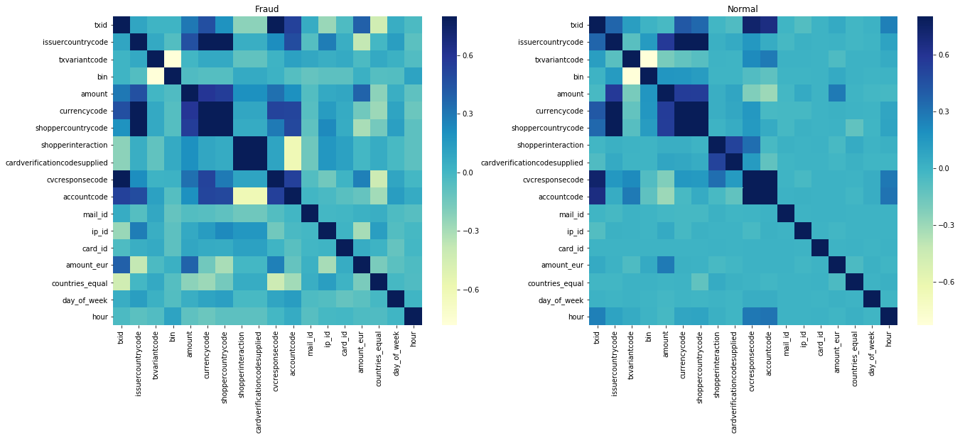
The power of heatmaps - fraud

Slide 76
Variables to handle carefully
simple_journal: Payment status. Authorised = “transaction approved and no fraud reported”, Refused = “transaction was declined, can be fraud, but can also be insufficient funds, etc”, Chargeback = “transaction was approved, but turned out to be fraud”
bookingdate: only relevant for Chargebacks. Time stamp when the chargeback was reported. During simulation you may only use this knowledge after this date. So for example if on an email address a transaction ended in a chargeback, you can only block that email address after the booking date of the chargeback.
creationdate: Date of transaction

